Slide 1
Adult Education by Age and Income IS362 Final Project
By
Kimesha Josephs

Slide 2
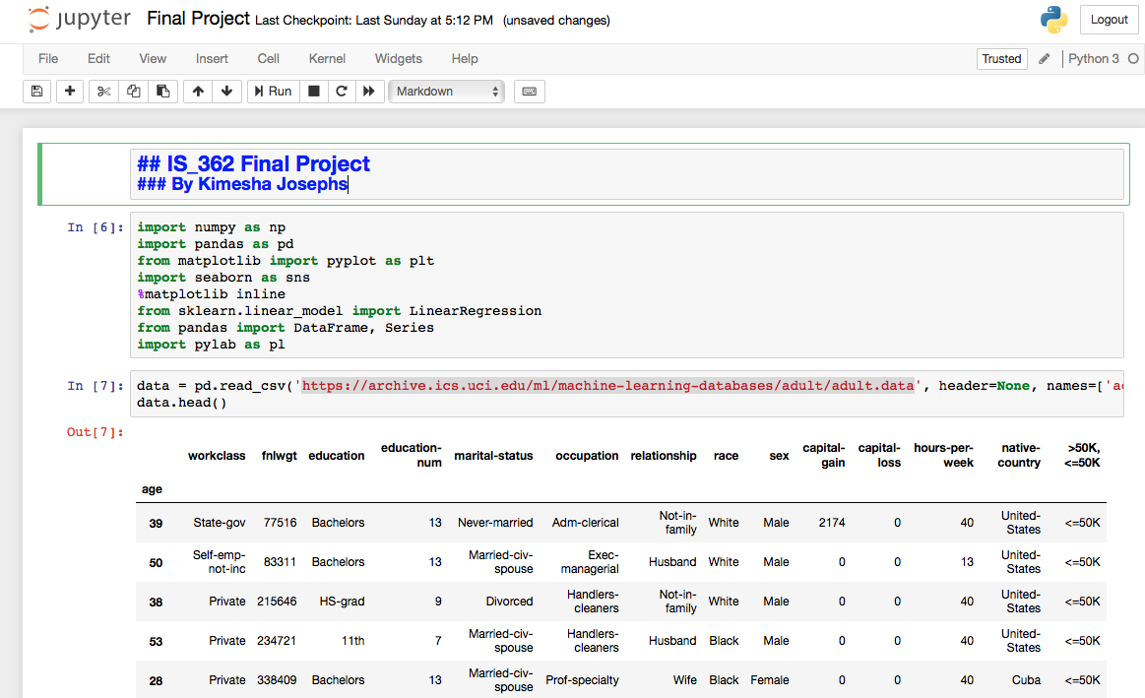
Populated adult education file

Slide 3
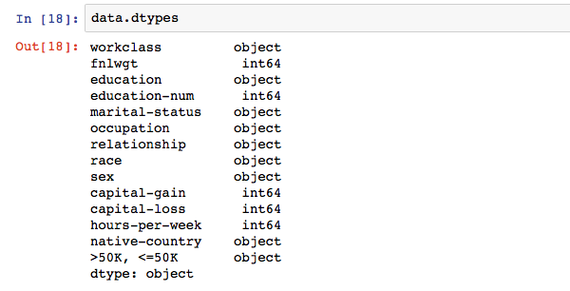
Checking for data types to understand information stored in data set.

Slide 4
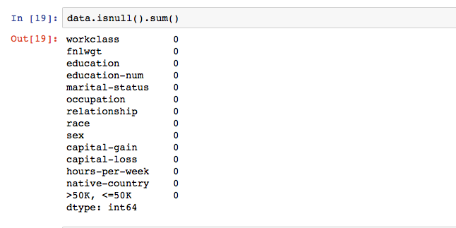
Cleaning data for Null values to assure the data accuracy and formatting the data.

Slide 5
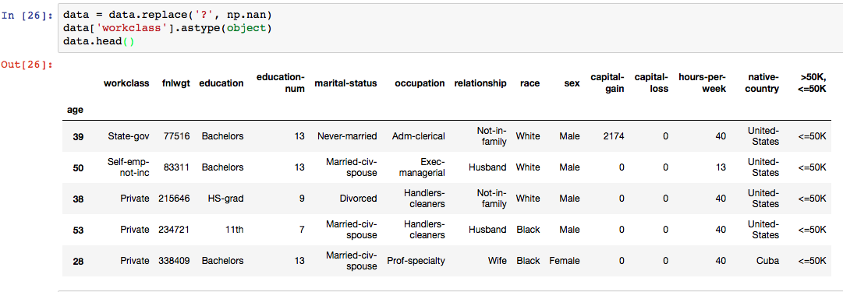
Tried to clean the data

Slide 6
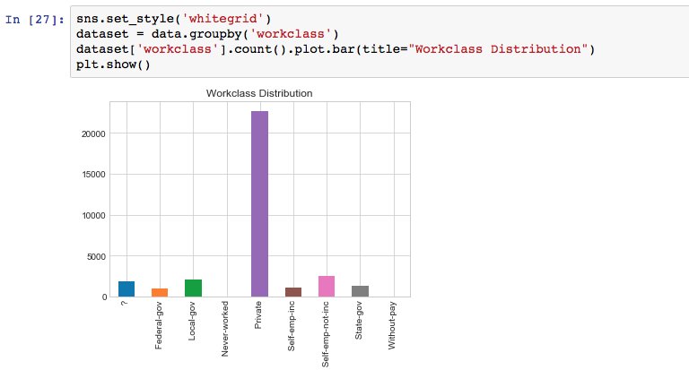
Data and Chart showing work class distribution

Slide 7
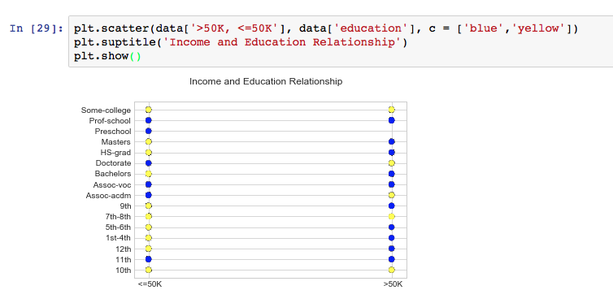
Chart showing the relationship between income and education

Slide 8
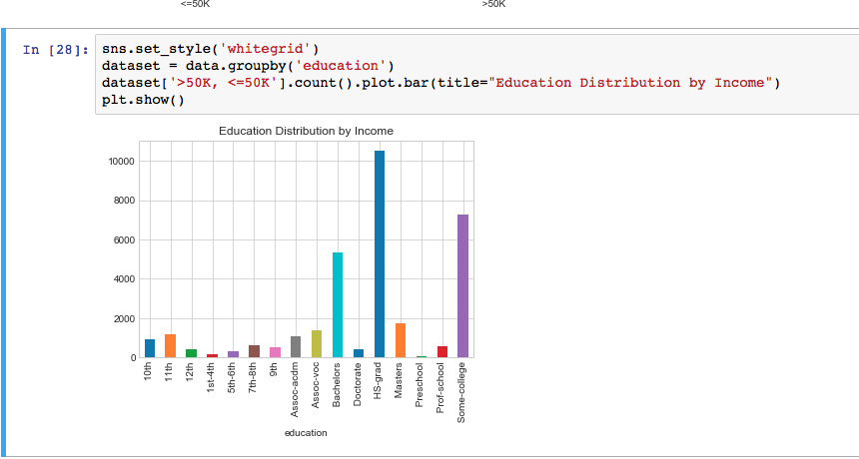
Education distribution by Income

